Slide 1
Automatic Detection of Cyberbullying
Presented by Guided By
MANJIMA M DR. FOUSIA M SHAMSUDEEN
Roll No:39

Slide 2
Introduction
The “Automatic Detection Of Cyberbullying” Project aims to develop an automated system to identify and mitigate instances of cyberbullying across digital platforms.
The project is created using Machine Learning and NLP techniques.
It focuses on model comparison, text preprocessing, and real-time prediction, making the detection process faster and more reliable.

Slide 3
Related Works
SI No. | Title | Authors and published year | Algorithms/ Techniques Used
1 | Social network features for cyberbullying detection | Zhang, Y., & Liu, J. (2021) | Social network analysis features
2 | Machine learning applications for cyberbullying detection: A review | Badali, H., & Fouladgar, M.(2022) | Traditional ML models, deep learning, ensemble methods
3 | Cyberbullying detection on social media using supervised machine learning | Cyberbullying detection on social media using supervised machine learning(2023) | Support Vector Machine (SVM), Random Forest

Slide 4
Gap Identified
Existing System
The existing system for detecting cyberbullying primarily relies on rule-based methods, keyword detection, or basic machine learning models trained on pre-labeled datasets.
Proposed System
The proposed system aims to improve upon the existing systems by using more advanced machine learning techniques and incorporating features

Slide 5
Objectives
Data collection and Preprocessing
Feature Extraction
Model Training
Model Evaluation and Optimization
Web Application Development
Deployment
User Interaction

Slide 6
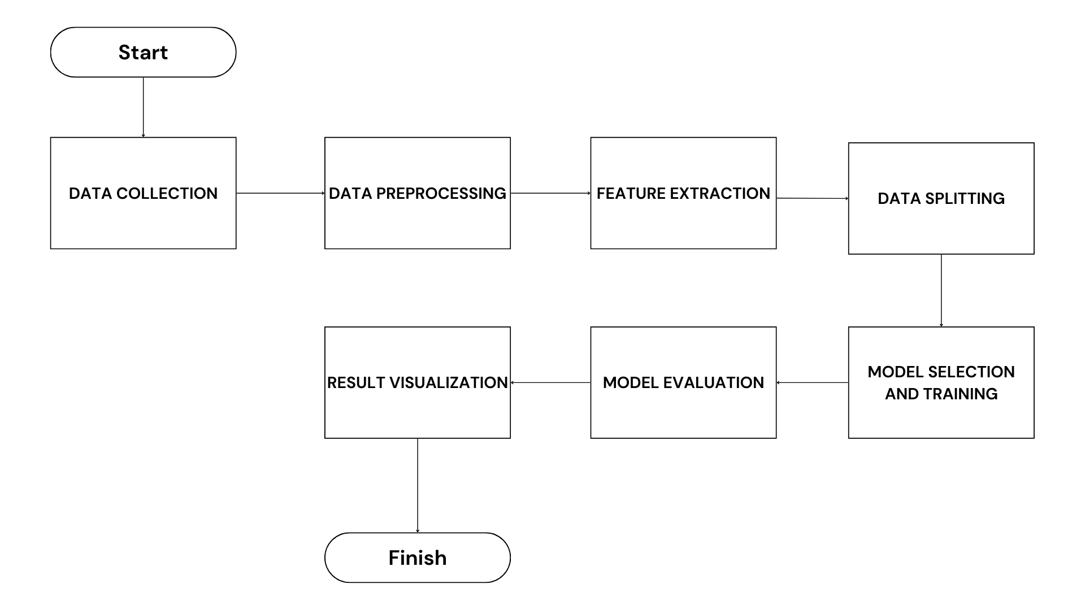
Methodology

Slide 7
Future Enhancements
Expand the system Capability to detect cyberbullying in multiple languages.
Real-Time Predictions with Enhanced Accuracy
Cross-platform Integration
User interface enhancement.

Slide 8
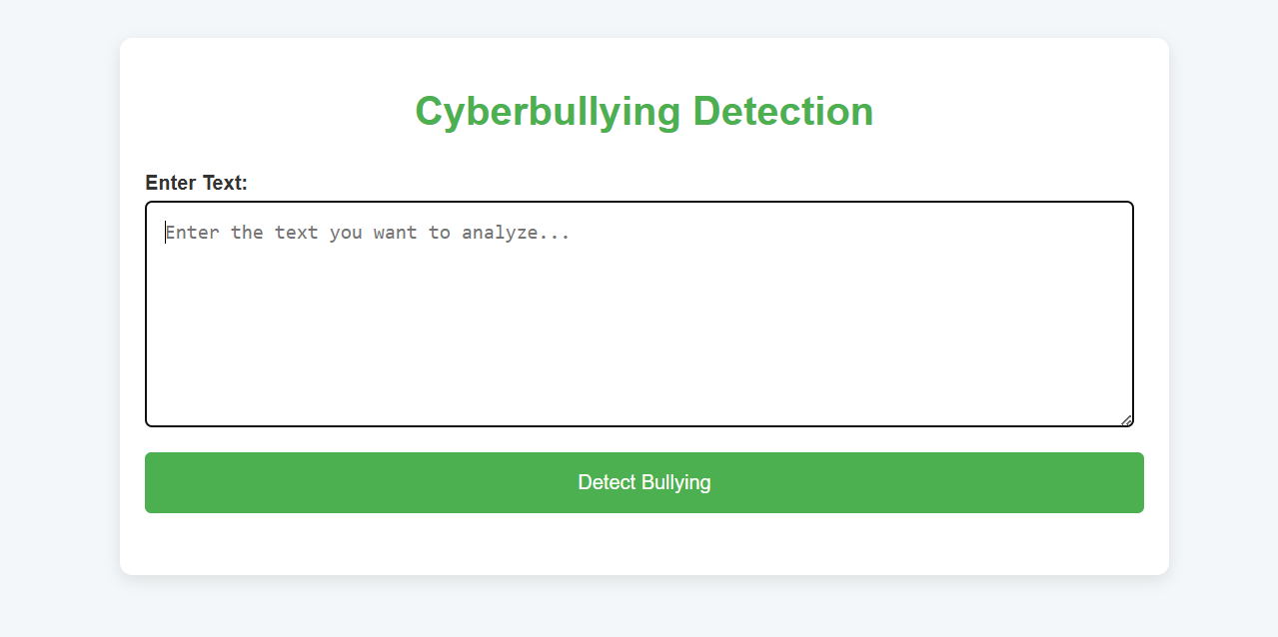
Results

Slide 9
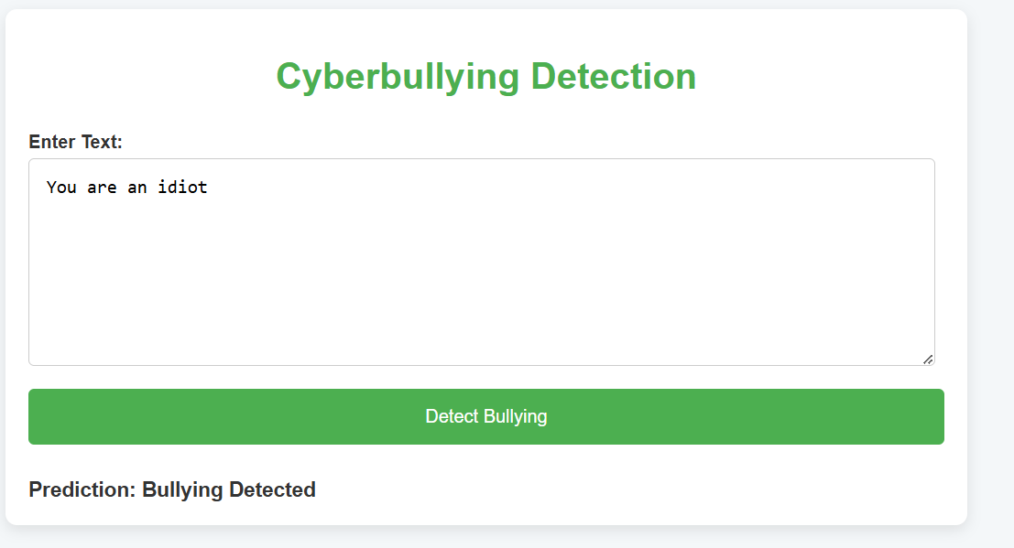

Slide 10
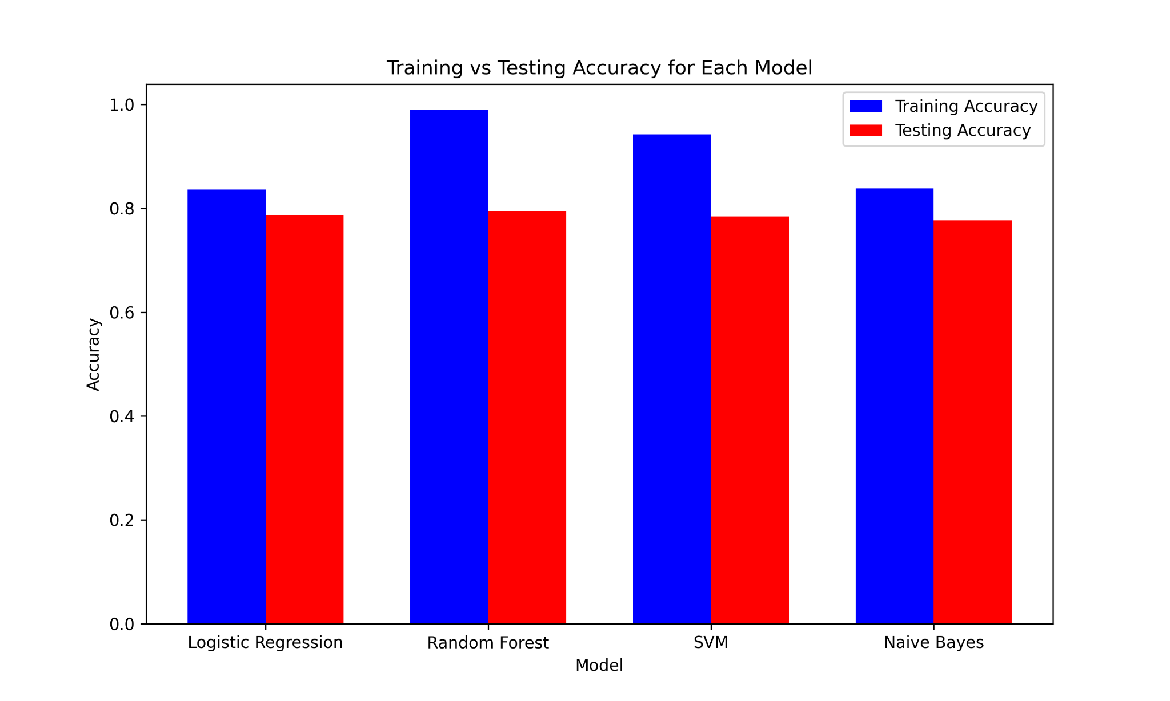

Slide 11
Conclusion
The Cyberbullying Detection System developed using Flask and machine learning techniques offers a robust solution for detecting harmful or abusive language in text data.
By leveraging various models like Logistic Regression, Random Forest, SVM, and Naive Bayes, the system efficiently processes textual data and provides predictions about whether a given input contains cyberbullying content.

Slide 12
Thank You

